Slide 1
Data Analytics Project 4
Exoplanet Exploration with Machine Learning
Jingbo Zhao & Ge Shen

Slide 2
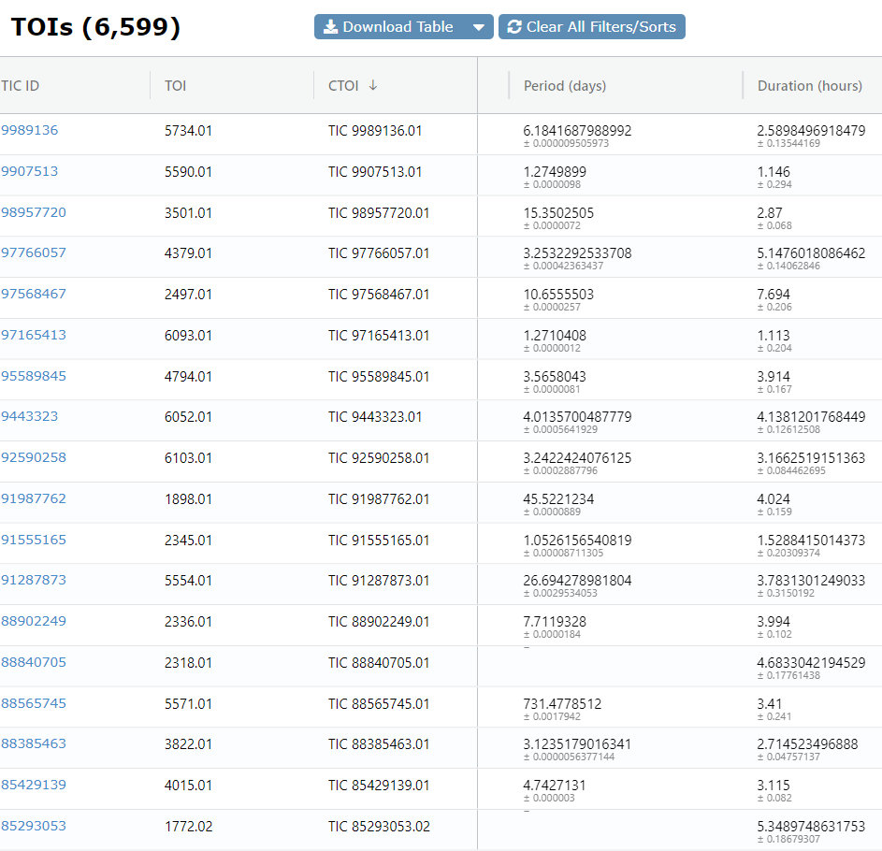
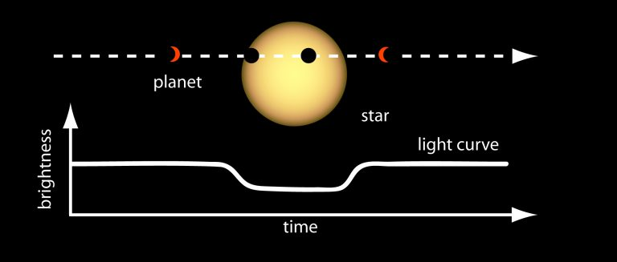
TESS Project Introduction
TESS is surveying the sky for two years to find transiting exoplanets around the brightest stars near Earth.
Image from: Transit via NASA
Notes:
Transiting Exoplanet Survey Satellite is a space telescope for NASA's Explorer program, designed to search for exoplanets using the transit method
Where Exoplanets are Planets that orbit around other stars beyond the solar system
The transit method can be used when the planet passing in front of its star ever so slightly dims its light
Exoplanet Follow-up Observing Program (EXOFOP) is the dataset we used in this project

Slide 3
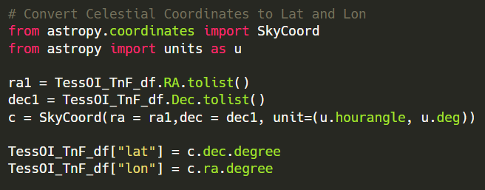
Preprocess Dataset
TESS Identification Columns:
TESS Object of Interest ID, TESS Input Catalog ID, …
Position Columns (celestial coordinates)
Right ascension, Declination, …
Planet Properties Columns
Planet Orbital Period, Planet Transit Duration, Planet Radius, …
Stellar Properties Columns
Stellar Distance, Stellar Effective Temperature, Stellar Radius, …
Drop non-beneficial ID columns
Assign TESS Disposition as the labels
Acronym of TESS Disposition
KP | Known planet | True: 1
CP | Confirmed planet
FP | False positive | False: 0
FA | False alarm
PC | Planetary candidate | To be predicted
Notes:
In the dataset, there are many columns of information
The position information are in celestial coordinates which

Slide 4
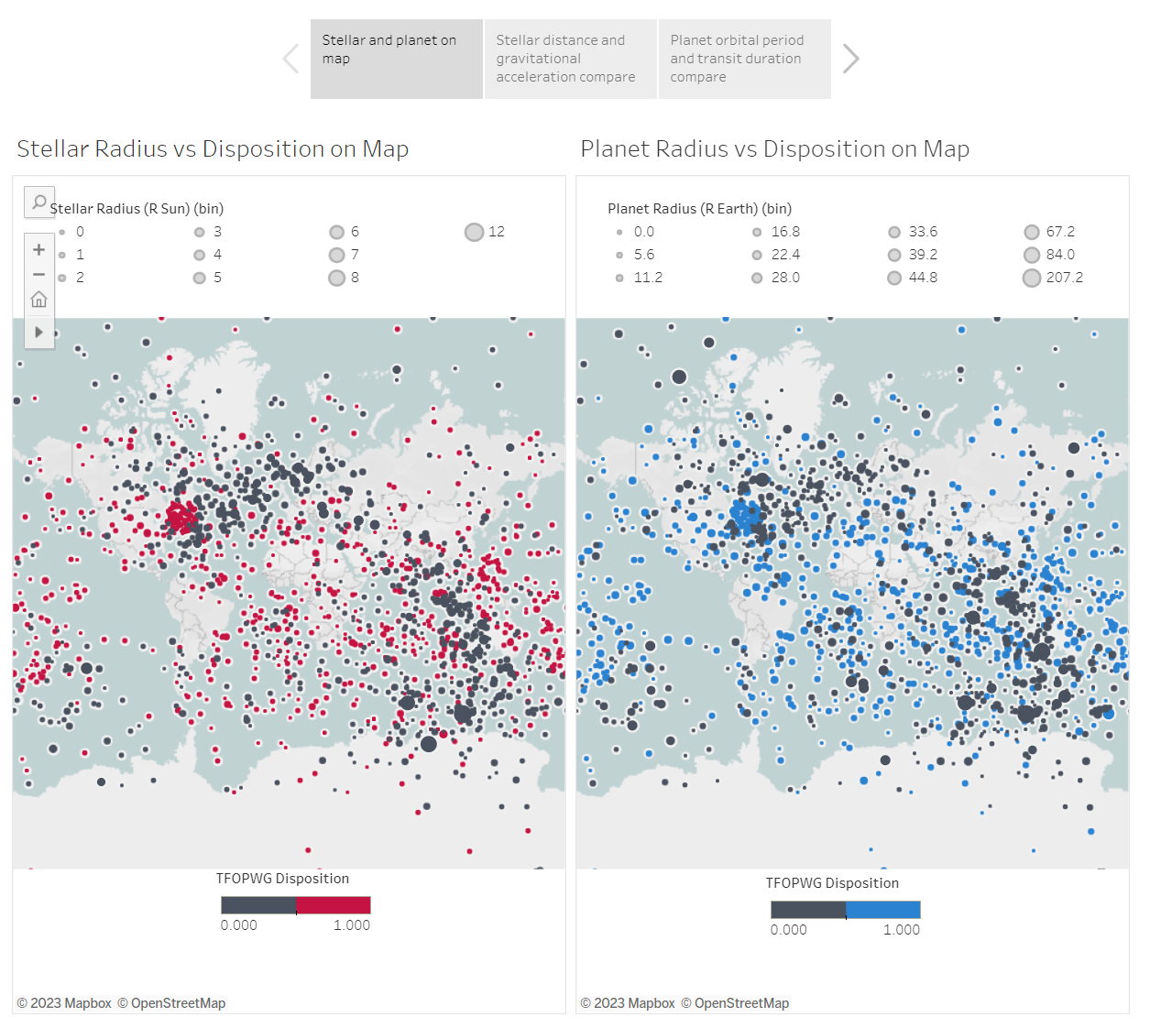
Visualization by Tableau
https://public.tableau.com/app/profile/jingbo.zhao/viz/Project4_16854590883040/Story1?publish=yes

Slide 5

Preprocess Dataset and Assumptions
Remove position columns (assume the universe is homogeneous)
Assume the existence of exoplanet is highly related to the properties of stellar and planet itself
Image from: https://images.app.goo.gl/gDH4HaFmcPCjz3Ww8

Slide 6
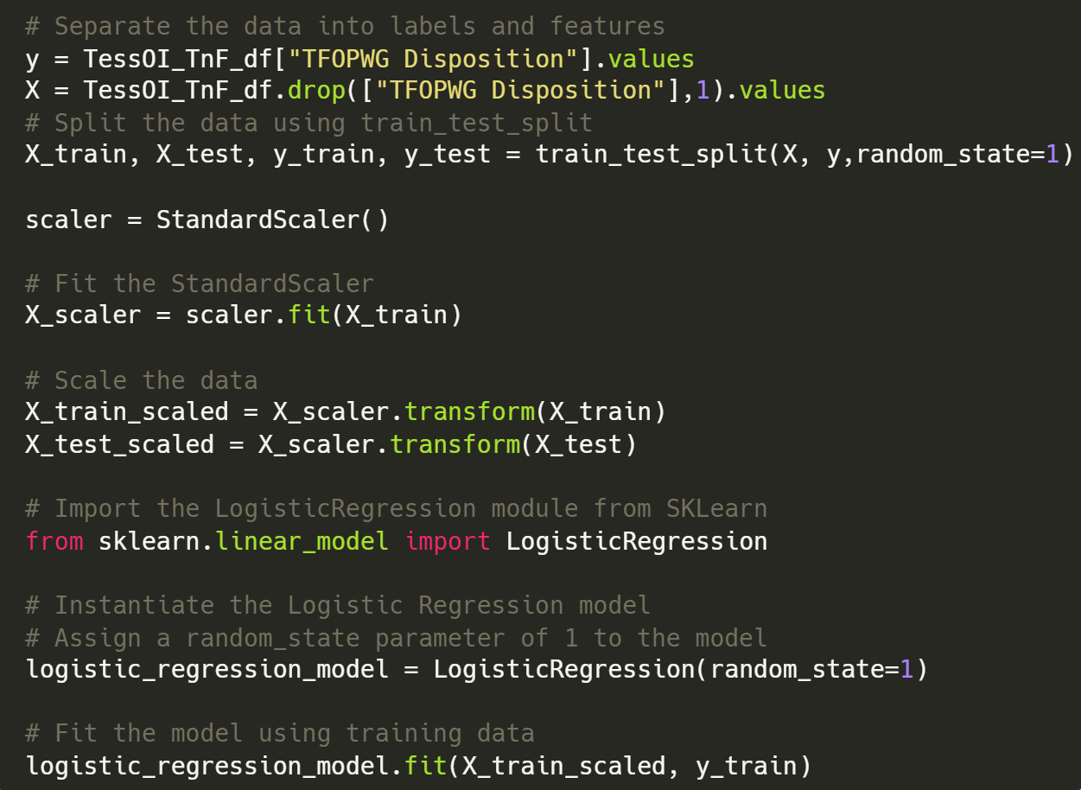
Supervised Machine Learning
The first model we trained is a supervised learning model, since the data and answers are known
Given this dataset has continuous valued variables, the logistic regression prediction is adopted

Slide 7
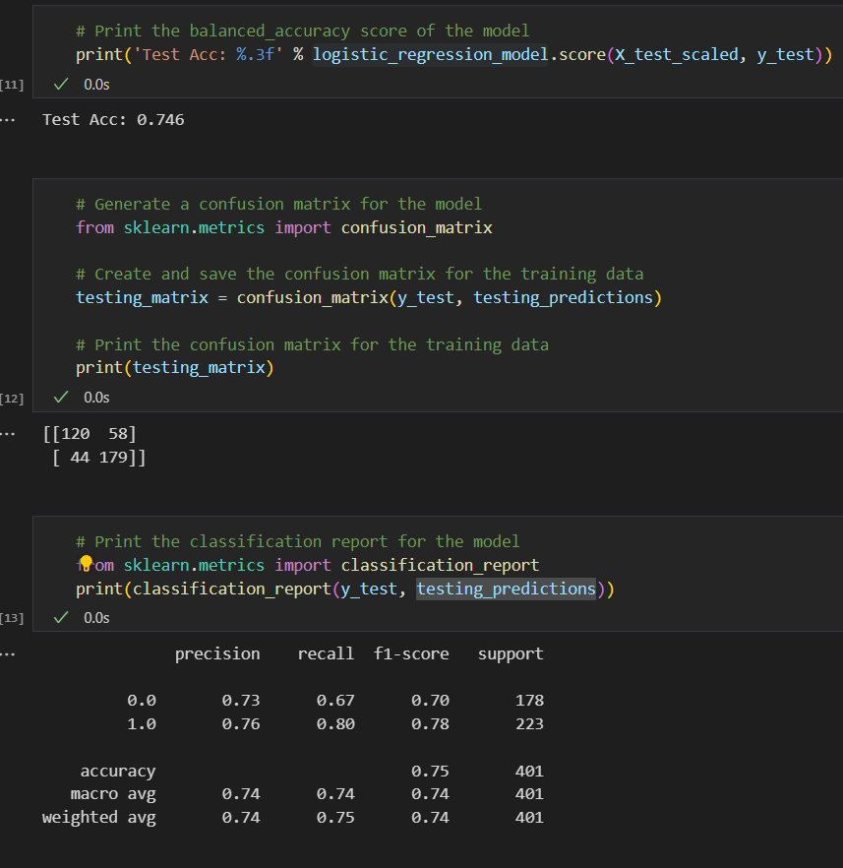
Result of Logistic Regression Prediction
Accuracy: 74.6%
False positive: 58
False negative: 44
In this case the false negative number is what we want to minimize.

Slide 8
Prediction with Deep Neural Network
Model Evaluation Methods
Keras-tuner
RandomizedSearchCV
Prediction with PC data

Slide 9
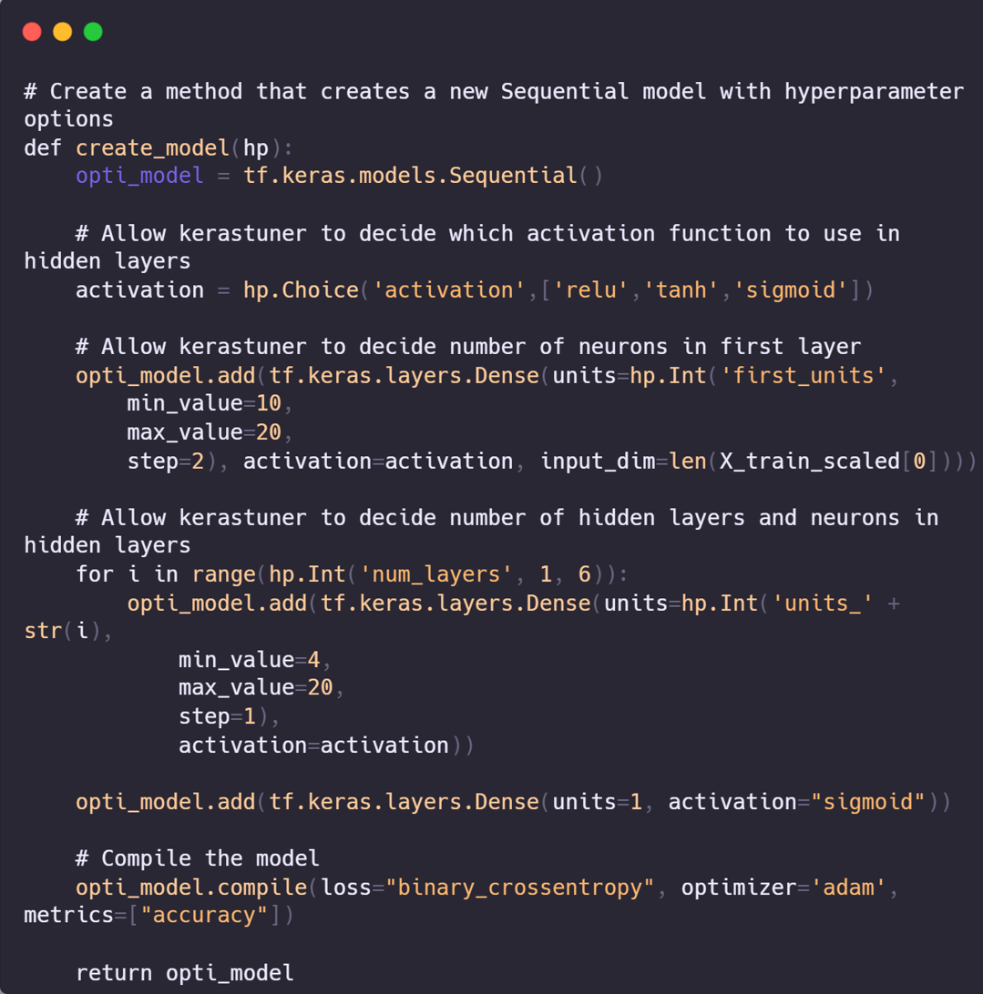
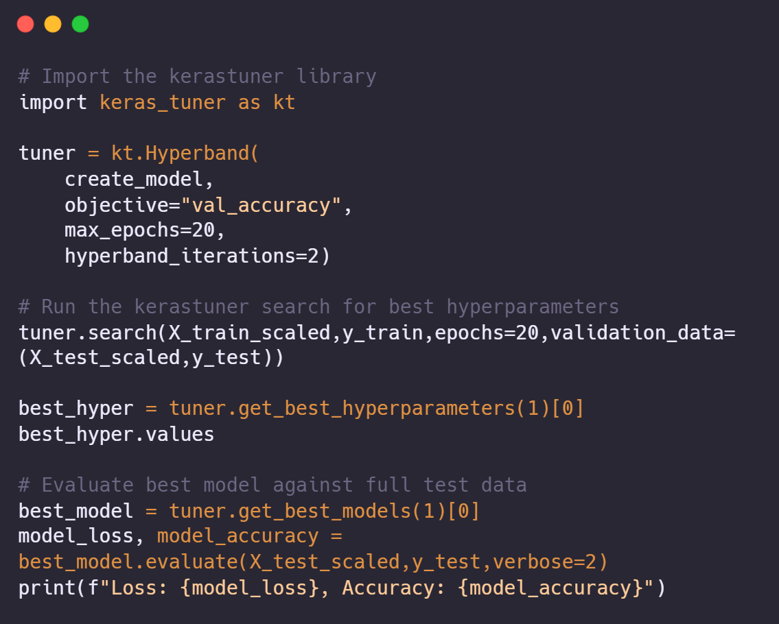
Keras - tuner

Slide 10
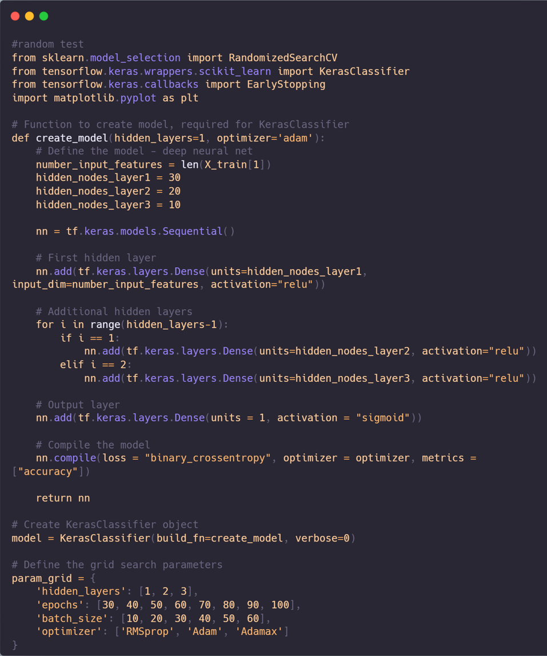
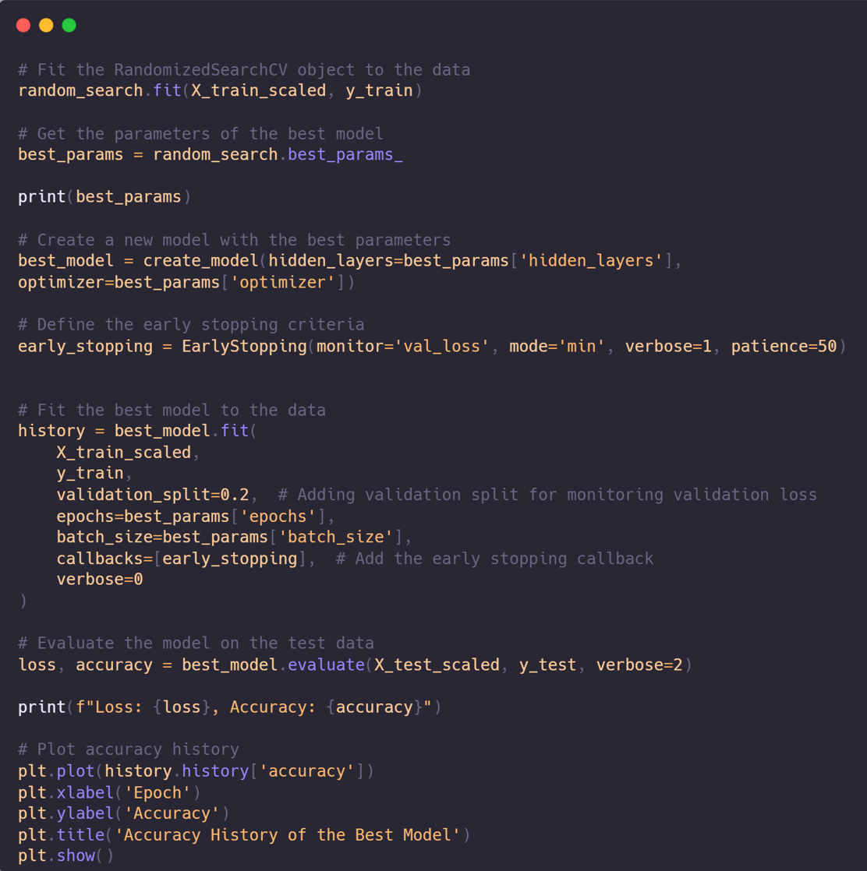
RandomizedSearchCV

Slide 11
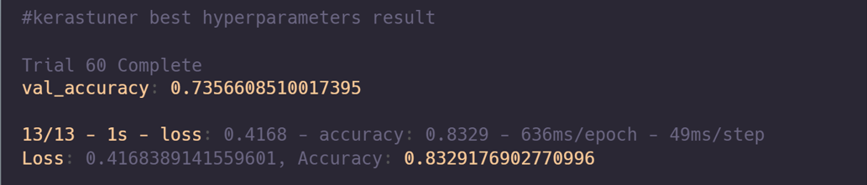
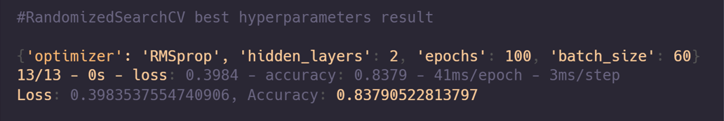
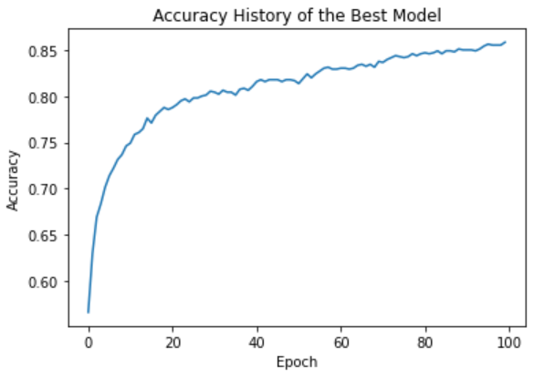
Keras - tuner results
RandomizedSearchCV

Slide 12
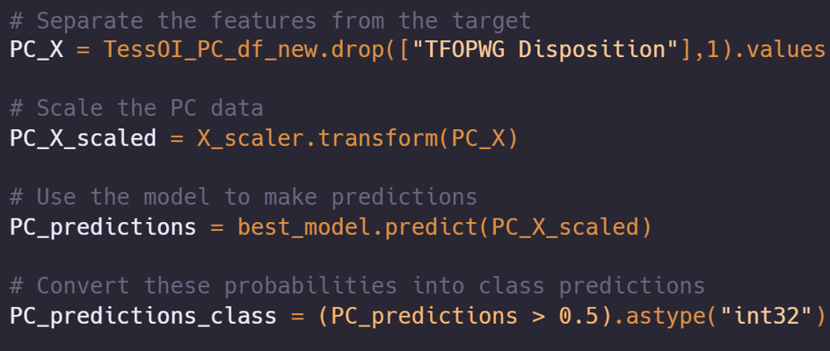
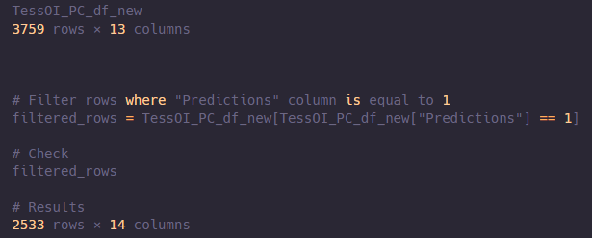
Prediction with PC data

Slide 13
Conclusion & Future improvement
Evaluation Methods | Tested Data (PC) | Result Data | Accuracy
logistic regression | 3759 | 2024 | 74.6%
RandomizedSearchCV | 3759 | 2533 | 83.8%
Future Improvement Aspects
Data Collection | More astronomical observation datasets.
B. Feature Engineering | Deepering into interrelationships and create new synthetic features
C. Combine Evaluation Methods | LR and Random
D. New Evaluation Methods | K-Fold,Cross-Validation,GridSearchCV

Slide 14

Thank you for Watching

